Slide 1
Correlating pathomics, radiomics and genomics analyses
Ellen Caroline Toledo do Nascimento
Hospital das Clínicas e Instituto do Coração da Universidade de São Paulo
Rede D’or

Slide 2
Declaração de Conflito de Interesse
Dr(a). Ellen C. T. do Nascimento afirma ter potenciais conflitos
de interesse a declarar
Atividades educacionais: AstraZeneca, MSD, Daiichi Sankyo
Exigência da RDC Nº 96/08 da ANVISA

Slide 3
Declaração Conflitos de Interesse
De acordo com a Resolução 1931/2009 do Conselho Federal de Medicina e com a RDC 96/2008 da ANVISA, declaro que:
Apresentações: como palestrante convidado participo dos eventos:
Não possuo ações de quaisquer destas companhias farmacêuticas.
Os meus pré requisitos para participar destas atividades são a autonomia do pensamento científico, a independência de opiniões e a liberdade de expressão que estas empresas respeitam.

Slide 4
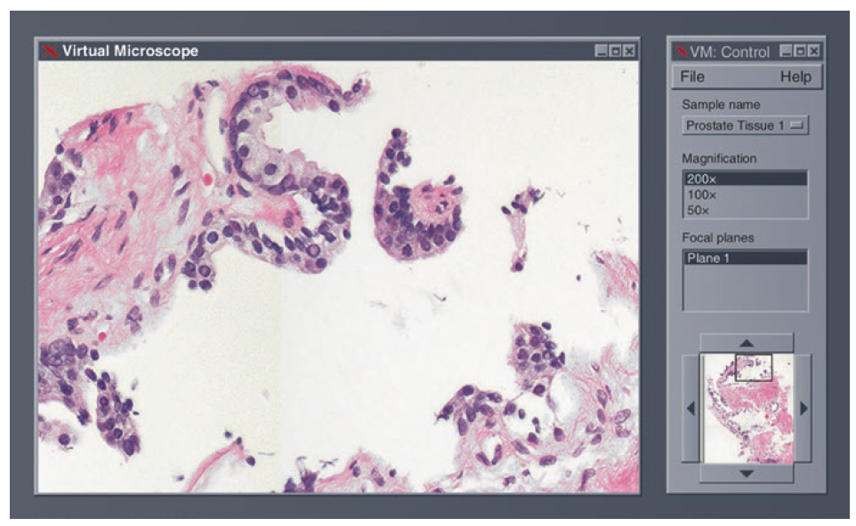
WSIs
Câmeras que captam imagem e gravam vídeos de amostras teciduais.
Scaners de lâminas emergiram há 20 anos.
WSIs (high-resolution whole slide images) de amostras teciduais estão disponíveis por meio de microscopia virtual.
1997 - 1998
Parwani AV. Springer Nature Switzerland. 2022.
Notes:
Nowadays, high-resolution whole slide images (WSIs) of histologic tissue samples are available on demand through virtual microscopy. Nova fronteira na medicina e ciência desde que os WSIs (high-resolution whole slide images).
Parwani AV. Springer Nature Switzerland. 2022.
This work is subject to copyright. All rights
Editor
Anil V. Parwani
Department of Pathology

Slide 5
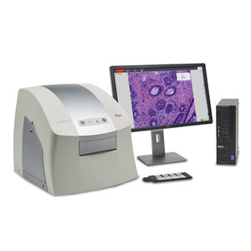
WSIs
Aplicações atuais:
Avaliação microscópica remota de ROSE;
Diagnóstico (inclusive com experts de subespecialidades);
Consultas intradepartamentais e com outras instituições.
Parwani AV. Springer Nature Switzerland. 2022.

Slide 6
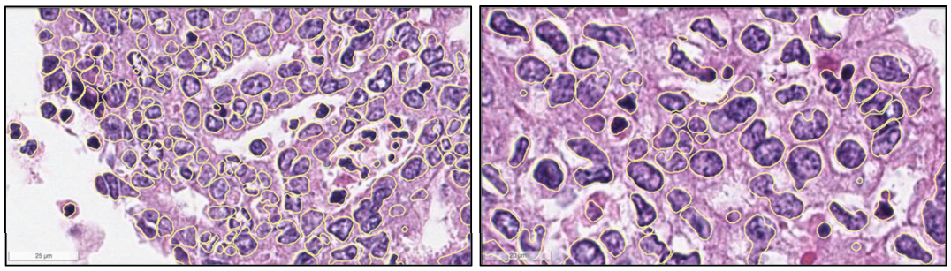
Definição:
Patologia digital atualmente engobla:
Imagens de slide total (“Whole slide Imaging”)
Telepatologia
Patologia computacional/Pathomics
Parwani AV. Springer Nature Switzerland. 2022.
Gupta R et al. Curr Pathobiol Rep 7, 73–84 (2019).
Notes:
Digital pathology became a vast new frontier in medicine and science ever since glass slide scanners emerged 20 years ago. Nowadays, high-resolution whole slide images (WSIs) of histologic tissue samples are available on demand through virtual microscopy.
The frst applications of telepathology utilized cameras to take pictures and record videos of tissue samples
Currently available applications of telepathology include remote microscopic examination for rapid on-site evaluation (ROSE) of cytology samples, primary diagnosis by pathologist with subspecialty expertise, and intradepartmental and outside institutional consultation for urgent, challenging, and diffcult cases.

Slide 7



Era da Medicina de Precisão
Novos conceitos
Novos insights da biologia tumoral
Notes:
Computational pathology is also being used to help understand the role of a wide range of hierarchical regulatory pathways in cancer, such as cell signaling by studying the spatial relationships of different populations of cells within the context of gene expression in the histologic landscape of cancer pathology

Slide 8
Pathomics
Variações morfológicas da doença estão relacionadas a eventos moleculares subjacentes e resultados/desfechos.
Sugerindo que análise morfométrica quantitativa pode prover informações adicionais sobre o mecanismo da doença.
Algoritmos de análise de imagem que vão desde escore de anticorpos/biomarcadores a segmentação e classificação celular.
Cooper LAD et al. J Am Med Inform Associ. 2012;19(2):317-323.
Notes:
image analysis algorithms now automate tasks ranging from antibody scoring to the segmentation and classifications of cells
Computational pathology is also being used to help understand the role of a wide range of hierarchical regulatory pathways in cancer, such as cell signaling by studying the spatial relationships of different populations of cells within the context of gene expression in the histologic landscape of cancer pathology
Pathomics analytics is very useful for performing standardized and uniform analyses that catalog different regions of tissue, cell populations, and nuclear characteristics along with a characterization of spatial properties and relationships in the tumor microenvironment, which can then be used to systematically explore the biological behavior of cancer in individual patients

Slide 9
Pathomics integra o cenário multi-omics provendo análise estrutural tecidual microscópica
ORGANIZAÇÃO
HIERÁRQUICA
Níveis teciduais:
Organelas subcelulares (microscopia eletrônica)
Células isoladas
Células organizadas em unidades funcionais em associação com matriz extracelular
Orgão ou tecido
Pathomics:
Lâmina histológica associada a infraestrutura computacional padronizada.
Ampla variedade de características podem ser extraídas:
Tamanho
Formato
Cor
Textura
Características derivadas da relação entre estruturas:
Distância entre estruturas e densidade de estruturas
Orientação geométrica
Várias estruturas podem construir uma unidade arquitetural tecidual e características podem ser extraídas
Bülow RD et al. NPJ Syst Biol Appl. 2023 Aug 7;9(1):38.
Notes:
Pathomics seamlessly integrates into the multi-omics landscape, providing the missing in-depth analyses of structural changes in tissues on a microscopic level (Fig. 1). In each tissue, microscopic histological structures can be defined on several levels. The currently smallest individual units are subcellular organelles. However, mainly nuclei can be visualized in standard histology, other subcellular organelles, or small organisms like viruses, and analysis of their morphology, normally requires ultrastructural analysis using electron microscopy. The next level is represented by single cells, followed by cells organized in functional units or compartments in association with the extracellular matrix, such as glands, interstitium or stroma, vessels and nerves. All these structures can be observed using light microscopy. Finally, the organization of these compartments defines the structure of the specific organ or tissue. These levels represent a connected multilevel hierarchical organization. wide range of features can be extracted from histological structures, such as size (area, length of axes, etc.)¹⁶, shape (circularity, eccentricity, elongation, etc.)⁹, color (hue, intensity, etc.) or texture (homogenous, heterogenous, etc.)¹¹. In addition, features can be derived from the relationship of histological structures to each other: distance between similar structures or structure density (for example, cellularity of a gland) and geometric orientation (for example, nuclear major axis orientation), A¹⁷. Lastly, several structures can build a tissue architectural unit that itself can express features, such as structure density or orientation of structures within and between units. Some features, such as color or texture, can be extracted from arbitrary regions of interest, such as image tiles, i.e., without defining a biologically meaningful structure expressing the features. Compared to molecular omics, which often require specific, costly infrastructure and sample preparation, pathomics uses the already available histological slides from the clinical routine and can be run on a rather standard computational infrastructure

Slide 10
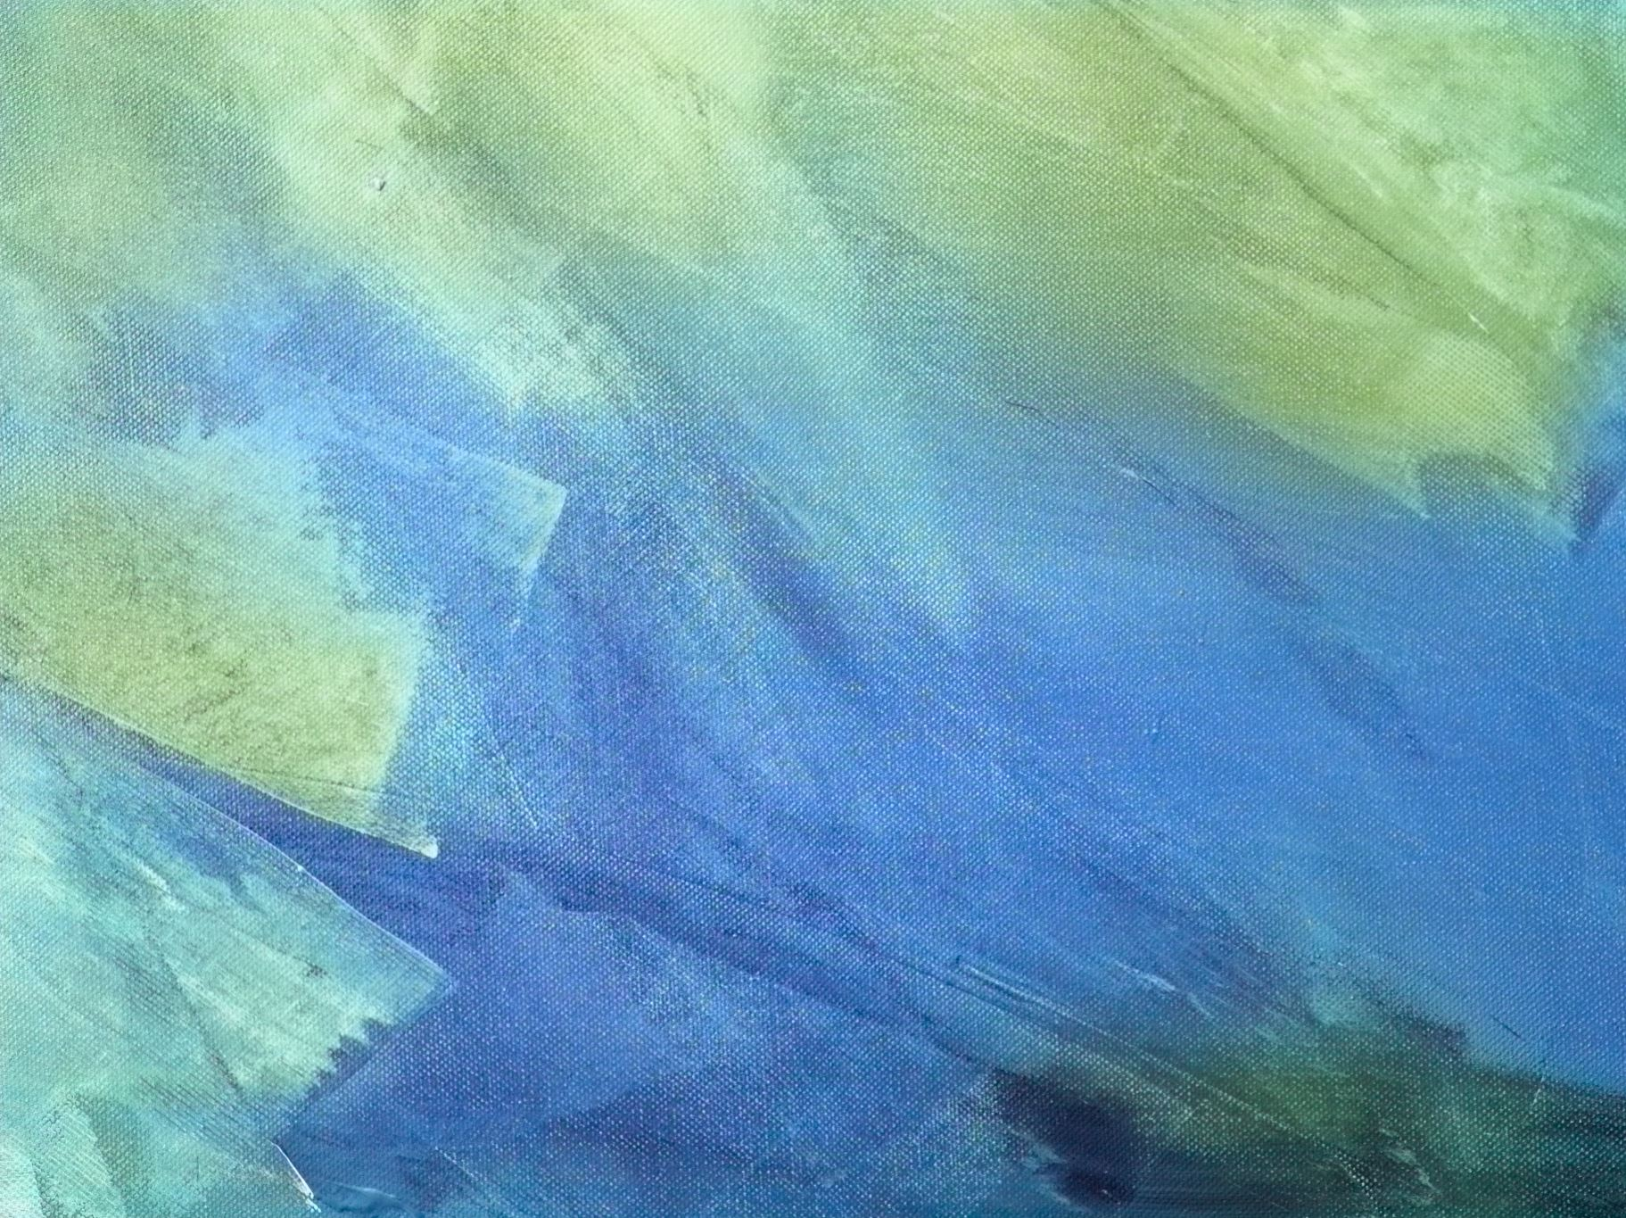
Pathomics - Definição
Pathomics ou histomorfometria quantitativa representa um processo de extração e mineração computadorizada para gerar medidas a partir das lâminas digitalizadas.
Enquanto a leitura de rotina pode predizer comportamento tumoral até certo grau, pathomics é um mecanismo sofisticado que revela atributos não visualizados.
Avaliação do arranjo “espacial” de todo o tumor presente na lâmina.
Chin J Cancer Res 2021;33(5):563-573
Notes:
Among these modalities, histological images are traditionally used for identifying and characterizing complex histopathological phenotypes, and the histological examination is generally considered as the “gold standard” for diagnosis of most solid tumors. With the advancements in high-speed highresolution whole slide image scanning hardware, the histological tissue slides can be digitized and analyzed efficiently. Pathomics or quantitative histomorphometric analysis refers to the process of extraction and mining of computer derived measurements from digitized histopathology images. While the visual reading of routine histopathology slides of tumors by pathologists can help predict cancer behavior to a certain degree, sophisticated pathomics has the potential to “unlock” more revealing sub-visual attributes about tumors (4). Perhaps, even more importantly pathomics enables a detailed spatial interrogation of the entire tumor landscape and its most invasive elements from a standard hematoxylin and eosin (H&E) slide. The research community has developed approaches quantifying nuclear arrangement, texture, and orientation for disease presence, risk, aggressiveness, progression and survival. These include not only the nuclear architecture and graphical arrangement of a single histologic primitive, but also novel approaches that are focused on characterizing the spatial arrangement (5-7) of tumor infiltrated lymphocytes (TILs) and interplays between multiple different histological primitives simultaneously [e.g. interplay of lymphocytes and cancer cells (8-10)], thus potentially providing a comprehensive portrait of tumor’s morphologic heterogeneity.

Slide 11
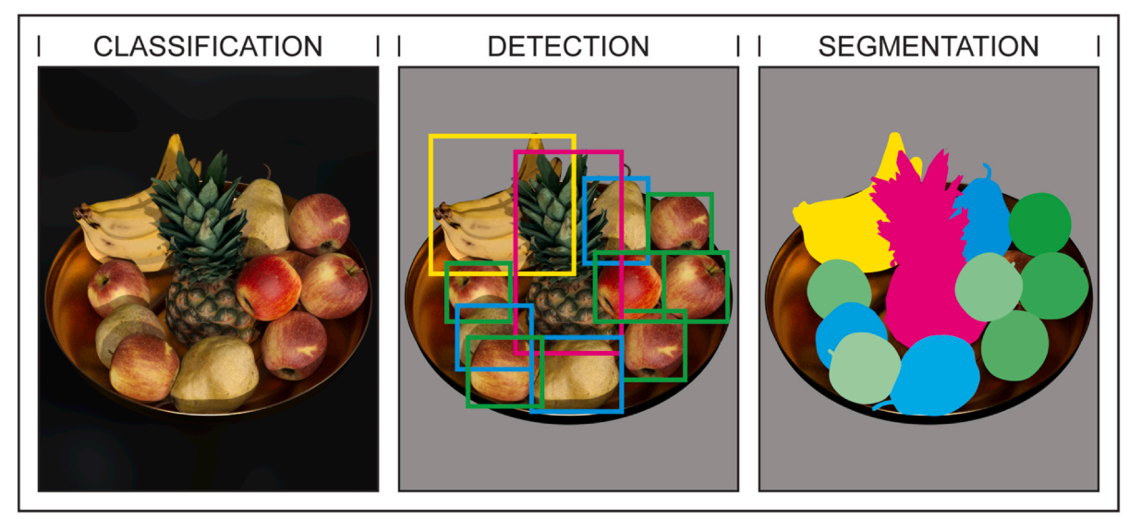
Princípios:
Aquisição da imagem
Segmentação
Processamento da imagem
Extração das características
Seleção das características/Construção do modelo/Análise
Singh S et al. Acad Radiol. 2024 Jan 28:S1076-6332(24)00024-2.
Notes:
Image analysis of tissues is based on the ability to (1) detect, (2) segment, (3) label, and (4) classify regions of tissue in terms of architectural elements, cells, nuclei, and other histologic features.

Slide 12
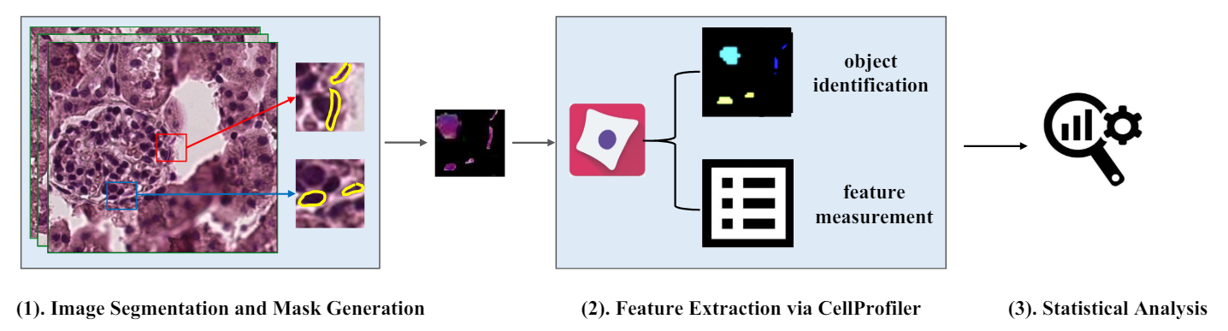
Patologia digital facilita a avaliação quantitativa de características diagnósticas, tipo celular, estruturas teciduais, mensuração tumoral, infiltração, padrões de crescimento, características nucleares, porcentagem de necrose...
Pathomics engloba a morfologia nuclear, classificação de tipo celular, caracterização espacial do tumor e estimação de biomarcadores.
CHEN, Jiayuan et al. Spatial pathomics toolkit for quantitative analysis of podocyte nuclei with histology and spatial transcriptomics data in renal pathology. In: Medical Imaging 2024: Digital and Computational Pathology. SPIE, 2024. p. 252-260.
Notes:
Digital pathology facilitates quantitative assessment of diagnostic features, providing crucial data on cell types, tissue structures, tumor measurements, invasive borders, growth patterns, nuclear characteristics, and necrosis percentages throughout WSIs. Pathomics applications encompass nucleus morphology, cell type classification, spatial tumor characterization, and biomarker-labeled cell estimation through immunohistochemistry

Slide 13
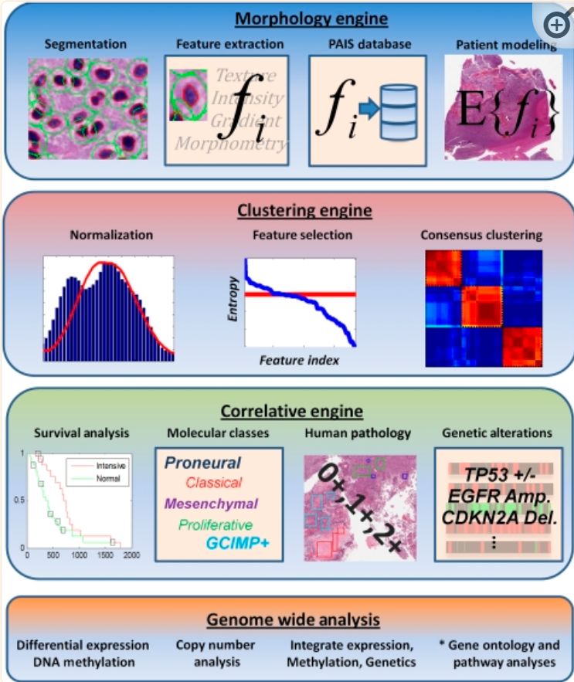
Assinaturas tumorais morfológicas em cada paciente são geradas por análise quantitativa de milhões de células e agrupadas para revelar grupos morfologicamente coesos.
Associação com desfecho clínico, resposta a tratamento e alterações genéticas em cada grupo.
Classes morfologicamente dirigidas.
Cooper LA et al. J Am Med Inform Assoc. 2012 Mar-Apr;19(2):317-23.
Notes:
image analysis algorithms now automate tasks ranging from antibody scoring to the segmentation and classifications of cells
The integrative morphologic/genomic analysis framework consists of four modules. The morphology engine produces and manages quantitative descriptions of hundreds of millions of cells. The clustering engine normalizes and filters data and identifies morphology-driven patient clusters. The correlative module analyzes clusters for associations with survival, treatment response, human evaluations of pathology, and recognized genetic alterations. Genome-wide analysis performs a deeper investigation of the transcriptional, genetic, and epigenetic associations, and mines these for biological themes and pathway activation.

Slide 14
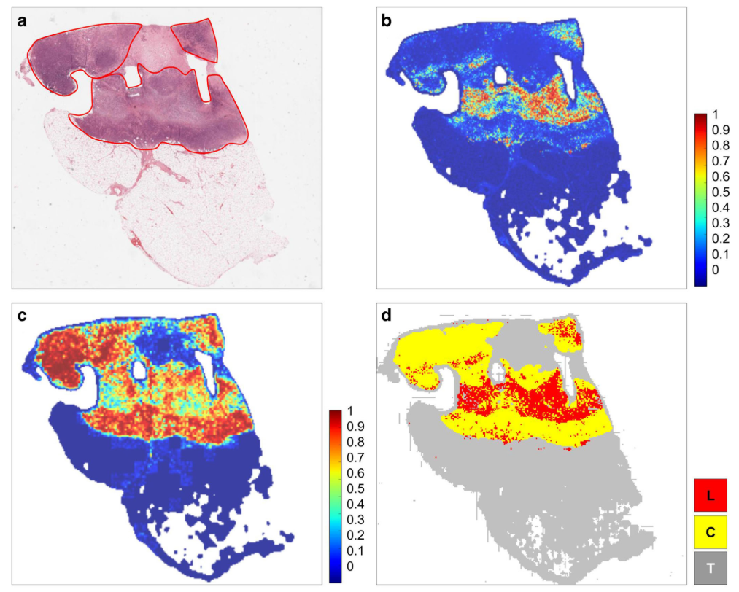
Avaliação de TILs (distribuição especial da resposta immune)
Câncer de mama
Mapa de probabilidade de detecção de tumor
Mapa de probabilidade de detecção de linfócitos
Tumor-TILs
Gupta R et al. Curr Pathobiol Rep 7, 73–84 (2019).
Notes:
Tumor-TILs map showing mostly peritumoral lymphocytic infltrates with scattered intratumoral TILs. (a) H&E, breast cancer, TCGA-A2-A0SP-01Z-00-DX1. (b) Tumor detection probability map. (c) Lymphocyte detection probability map. (d) Tumor-TILs maps with cancer in yellow and lymphocytes in red. (L lymphocytes, C cancer; and T non-tumor non-lymphocyte background tissue). The distribution of tumor immune responses is qualitatively different from Fig. 5 with a more muted immune response. We observe mostly peritumoral TILs in localized areas containing scattered intratumoral TILs. Pathomics analyses like Tumor-TILs mapping can easily be performed in large collections of WSIs in a scalable fashion to virtually analyze tissue samples for each patient in order to stratify candidates for immunotherapy. These kinds of Pathomics analyses can also be integrated with other types of image analysis methods in order to systematically extract and catalog quantitative data about various phenotypic properties of tissues, cells, and nuclei

Slide 15

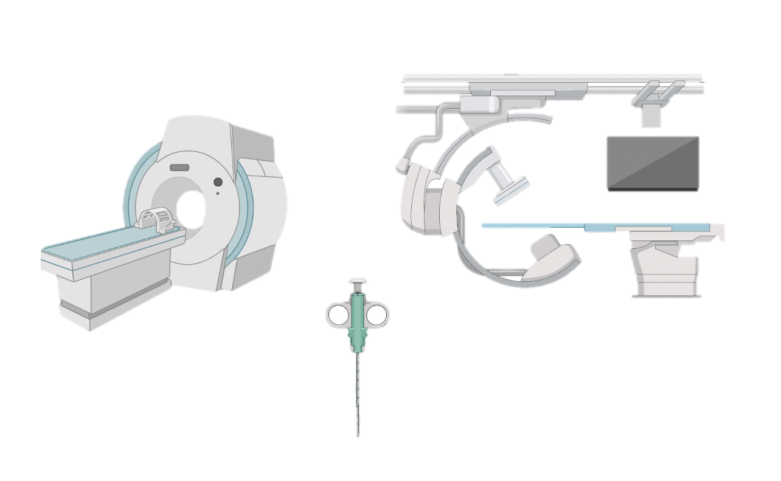
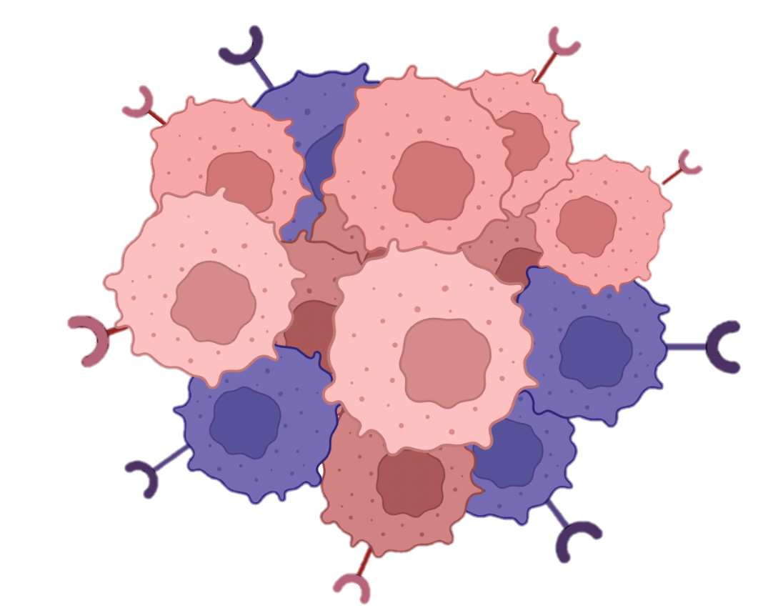

Heterogeneidade intratumoral
Diferença de morfologia nuclear (pleomorfismo) é tradicionalmente marcador de câncer e também de diferenciação tumoral.
Quantificação da diversidade morfológica subvisual no tecido deveria ser um bom substituto para heterogeneidade genética intratumoral.
Lu C, Lancet Digit Health. 2020 Nov;2(11):e594-e606.
Notes:
TH and macrodiversity, understanding of the temporal features of clonal evolution remains limited owing to ethical and logistical challenges in obtaining serial single- or multi-regional biopsies from patients

Slide 16
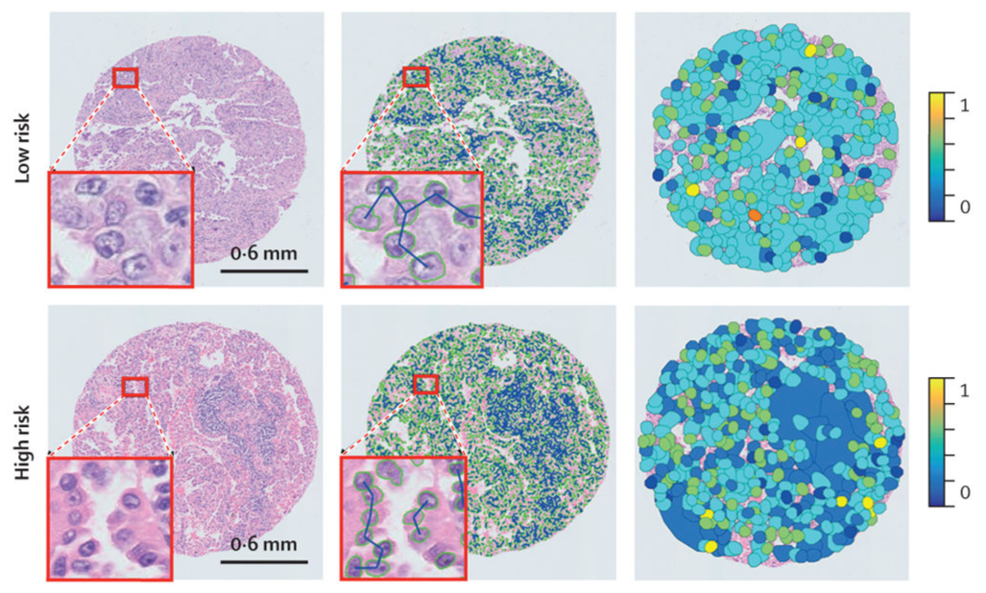
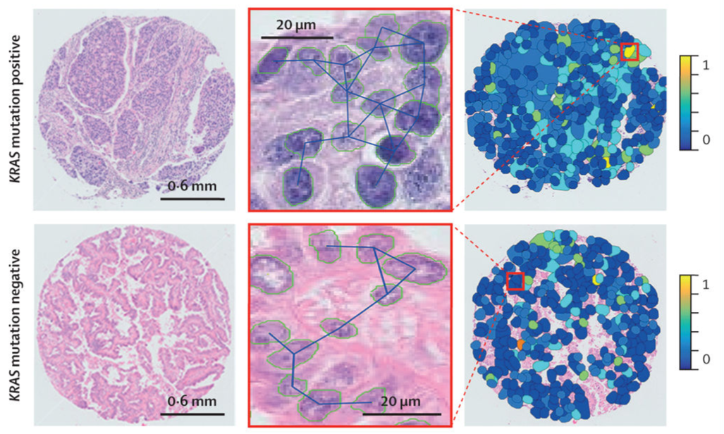
Heterogeneidade Intratumoral
Modelo de risco LUAD
Cohort de treino
Cohort de validação
Classificação do status mutacional
Núcleo é segmentado – LNG (“local nuclear graph”) construído – características são extraídas e usadas para calcular escore de risco baseado na diversidade celular.
Lu C, Lancet Digit Health. 2020 Nov;2(11):e594-e606.
Notes:
Intratumoural heterogeneity has been previously shown to be related to clonal evolution and genetic instability and associated with tumour progression. Phenotypically, it is reflected in the diversity of appearance and morphology within cell populations.
blue and yellow colours represent the low and high normalised feature values
Nuclear morphological differences or nuclear pleomorphism have traditionally been known to be pathognomonic of cancer and a marker for tumour differentiation.6 This genetic intratumoural heterogeneity is reflected in the morphological makeup of the tissue, with more rapidly growing or aggressive cancers showing a greater cellular heterogeneity among cancer cells compared with a relatively indolent tumour.7 Tumours with higher intratumoural heterogeneity and higher nuclear diversity have been shown to have a poorer prognosis than cancers with low intratumoural heterogeneity and less nuclear diversity. Thus, quantifying this sub-visual morphological diversity in tissues would be a good surrogate for genetic intratumoural heterogeneity.

Slide 17


EPÍGRAFE
O problema da IA não é ela errar.
O problema da IA não é ela errar
O problema da IA é ela errar e nos convencer de que está certa
O problema da IA é ela errar e nos convencer de que está certa.
PENSAMENTO CRÍTICO
Pensamento
crítico
Métodos computacionais tem limitações e biases baseadas:
Na qualidade do dataset de treinamento;
Na variabilidade dos dados que o modelo usa durante o treinamento
Resumo: modelos baseados em deep learning models não são infalíveis e ocasionalmente podem falhar principalmente nas interpretações da complexidade do microambiente histológico.
van der Laak J, Litjens G, Ciompi F. Nat Med. 2021 May;27(5):775-784.
Notes:
van der Laak J, Litjens G, Ciompi F. Deep learning in histopathology: the path to the clinic. Nat Med. 2021 May;27(5):775-784. doi: 10.1038/s41591-021-01343-4. Epub 2021 May 14. PMID: 33990804.
The typical workfow in developing these kinds of algorithms includes design, annotating WSIs, development of deep learning models, testing, validation in an independent dataset, and iterative refnement before deployment with appropriate QA/QC mechanisms, which is no different than what would be expected in the development and implementation in any kind of laboratory testing. As fascinating as it is to see the kinds of analyses that can be performed with deep learning pathomics applications, we must remember that these computational methods have limitations and biases based on the quality of the training dataset and spectrum of variability of the data points that the models use during training. In other words, we need to understand that deep learning models are not infallible and will occasionally fail, especially within the context of interpreting the complexity of the histologic microenvironment in healthy and diseased tissues

Slide 18



IA e Integração de Dados
Dados clínicos e laboratoriais
Radiologia
Patologia
Genômica
Notes:
Dagogo-Jack

Slide 19
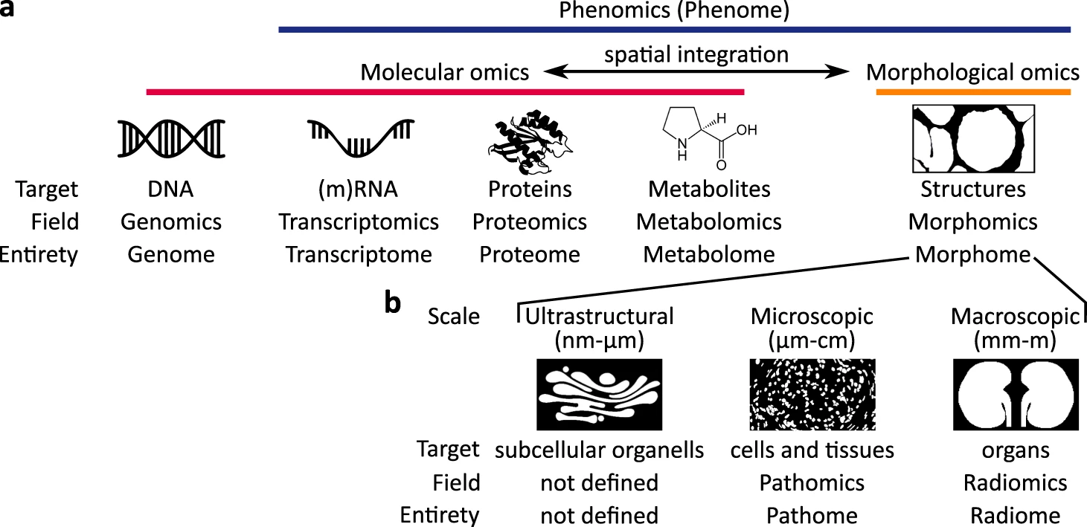
Molecular Omics e Morfológico Omics
Bülow RD et al. NPJ Syst Biol Appl. 2023 Aug 7;9(1):38.
Notes:
Classical molecular omics can be complemented by morphomics, comprehensively quantifying tissue structure. Particularly, the integration of spatial molecular and morphological omics can provide new insights into tissue organization and diseases. b Morphomics analysis at different scales, ultrastructural, microscopic and macroscopic. These approaches were missing important information on the spatial organization and structure of the analyzed tissues and organs. Recent approaches allow the integration of the relative position of the investigated instance, most commonly honeycomb-shaped tissue areas, within a given sample using spatial transcriptomics (for example, spatially resolved transcript amplicon readout mapping (STARmap) or NGS barcoding techniques)⁵ or spatial proteomics (e.g., multiplexed antibody-based imaging methods: multi-epitope-ligand cartography (MELC), tissue-based cyclic immunofluorescence (t-CyCIF))⁶. Even though spatial technologies are still evolving, their potential to further extend deep tissue phenotyping is increasingly recognized. The missing piece remains the lack of structural morphological information on an ultrastructural, microscopic, and macroscopic scale. These are the fundamental tasks of pathology, which remains the cornerstone of tissue diagnostics of human diseases.
Particularly, the integration of spatial molecular and morphological omics can provide new insights into tissue organization and diseases.

Slide 20
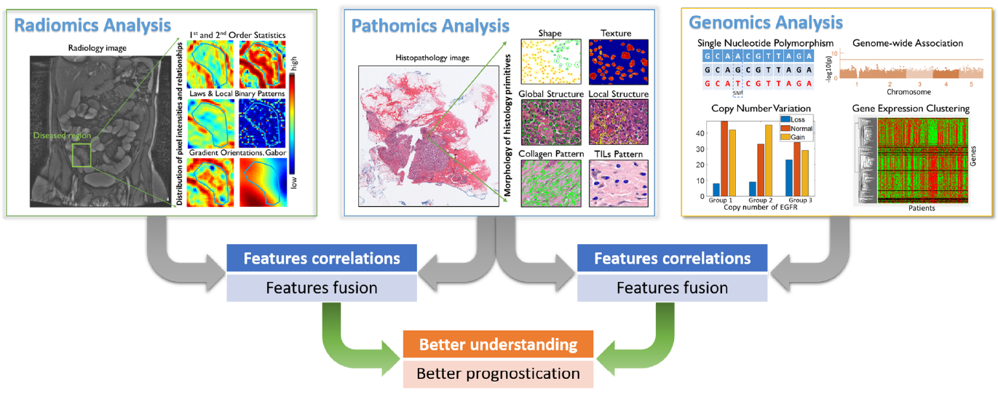
Fusão de pathomics, radiomics e análise genômica
Assinaturas/características associadas a desfecho clínico podem ser associadas e fundidas para criar uma melhor ferramenta prognóstica.
Lu C, Shiradkar R, Liu Z. Chin J Cancer Res. 2021 Oct 31;33(5):563-573.
Notes:
fusion of pathomics, radiomics and genomics analyses. In the context of prognosis, features/signatures that associated with patient outcomes from different
modalities can be associated and fused, in order to better understand the relationship of disease genotypes and genotypes and to create
better prognostic tools.

Slide 21

O FUTURO
é híbrido

Slide 22
obrigadA!
Agradecimento:
Jose Araujo-Filho, MD, PhD
Hospital Sirio-Libanes ǀ Grupo Fleury ǀ Society of Thoracic Radiology
ellen.nascimento@hc.fm.usp.br

